Slide 1

Code Refactoring and Bug Fixing

Slide 2
About
Name: Nitish Kumar Akula
Specialization : Bachelor's Degree in Electronics
Any work experience: Fresher
LinkedIn : www.linkedin.com/in/nitish-kumar-akula
Git Hub : https://github.com/nitish-innomatics

Slide 3
Title:
Refactoring and Debugging a Python Flask Note Taking Application
Objective:
The aim of this assignment is to enhance the Python Flask Note Taking Application by refactoring the existing codebase, addressing bugs, and ensuring seamless functionality.

Slide 4
Steps involved in Bug Fixing
Identify the Issue: The code currently only handles POST requests, leading to the non-display of notes initially.
Update Route Method: Integrate "GET" into the list of accepted methods within the route to effectively manage both POST and GET requests.
Fetch Notes for GET Requests: Adapt the index function to retrieve notes and transmit them to the template for processing in the case of GET requests.
Correct Retrieval of Note: In the index function, ensure proper note retrieval from form data using `request.form.get("note")` specifically for POST requests.
Handle Empty Note: Implement a check to verify that the note is not empty before appending it to the notes list, preventing the inclusion of empty notes.
Render Template: Conclude the process by returning the rendered template with the updated list of notes.

Slide 5
HTML Snippet
Add Heading: Introduce an <h1> heading to denote the note-taking application.
Update Form Action: Adjust the form action attribute to "/" to enable the submission of data to the URL using the POST method.
Specify Button Type: Clearly define the type attribute for the "submit" button, specifying its function as a submit button.
Conditional Display of Notes: Incorporate conditional statements within the template to verify the availability of notes before displaying them.
Handle Empty Notes: Implement a mechanism to address situations where no notes are available for display.

Slide 6
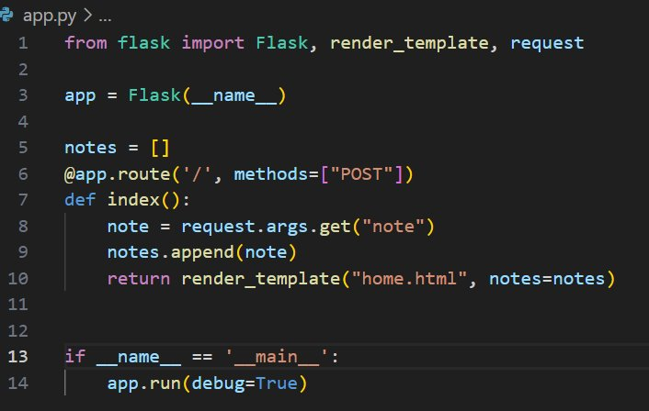
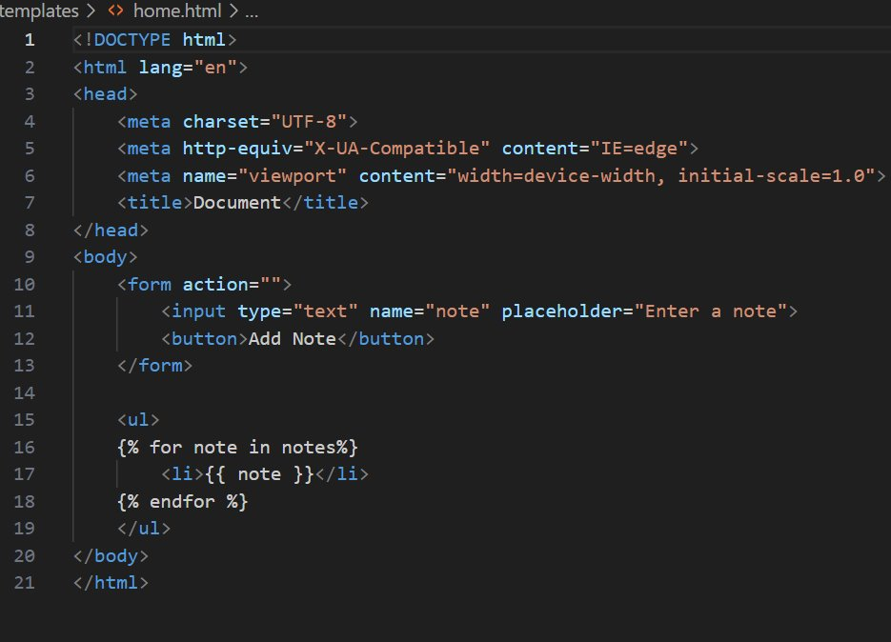
Before Bug Fixing
Flask Code Snippet:
HTML Code Snippet:

Slide 7
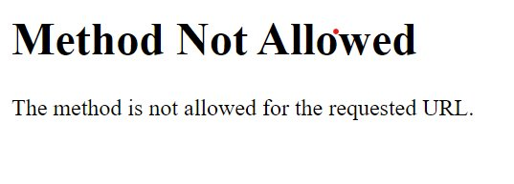
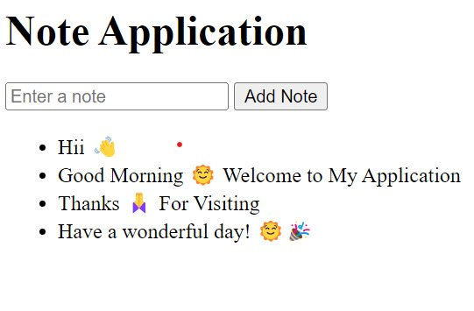
Output
Before Bug Fixing:
After Bug Fixing:

Slide 8
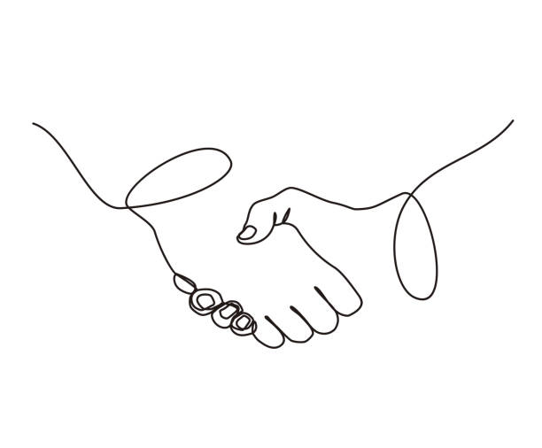

THANK YOU

